Slide 1
Progress Report 7-19-2024

Slide 2
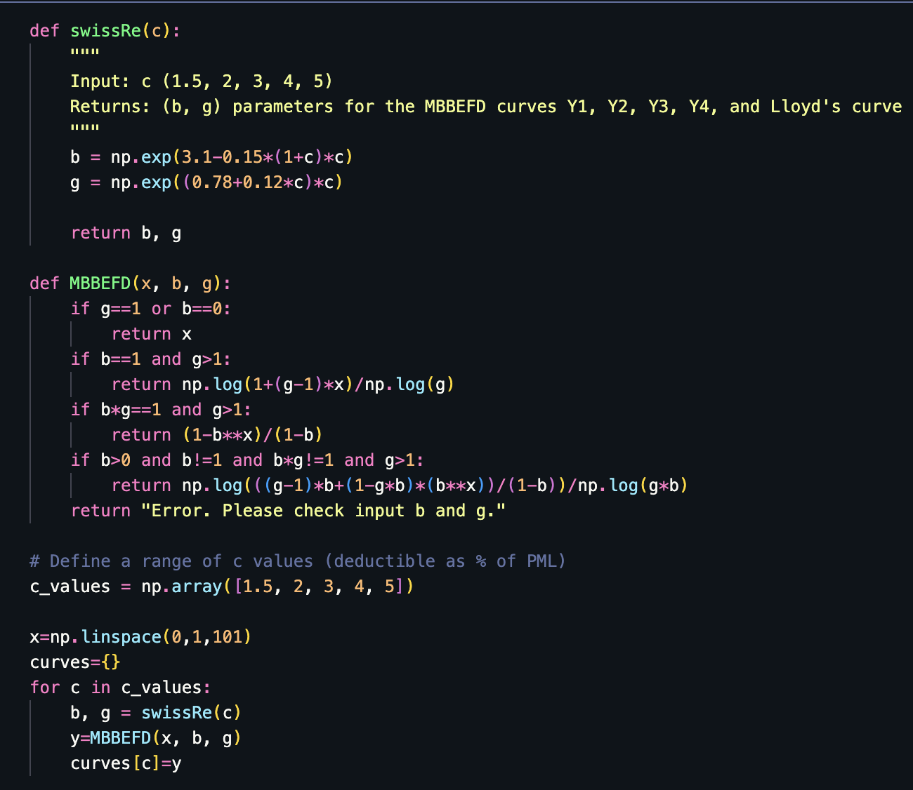
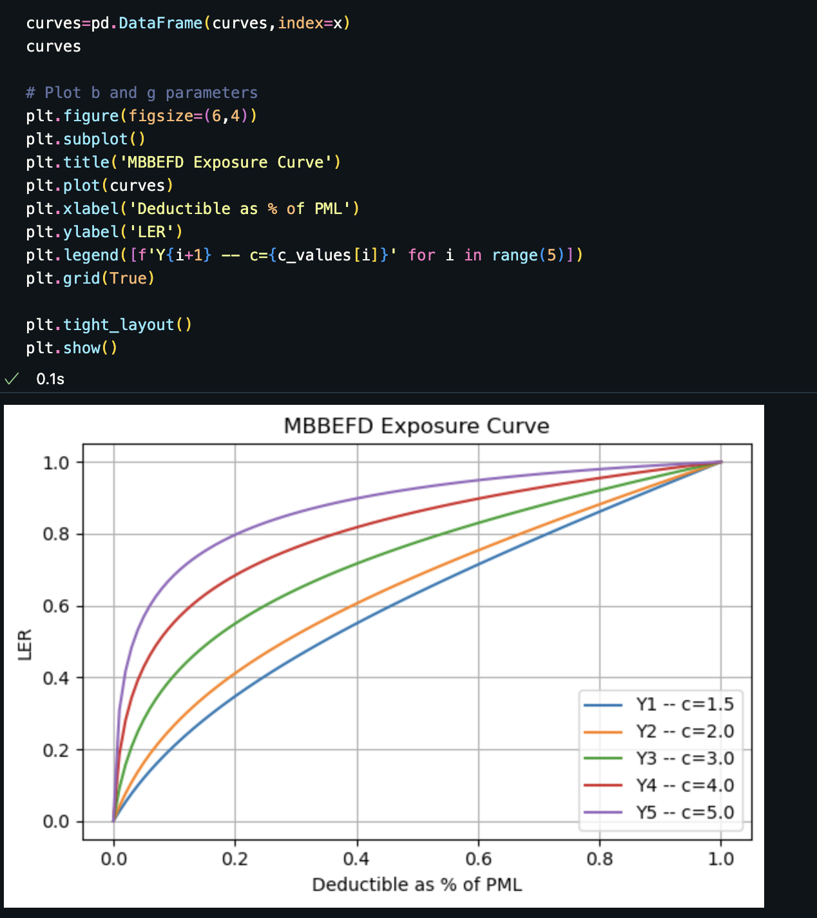
01 - Implement MBBEFD & Swiss Re Curve with Python

Slide 3
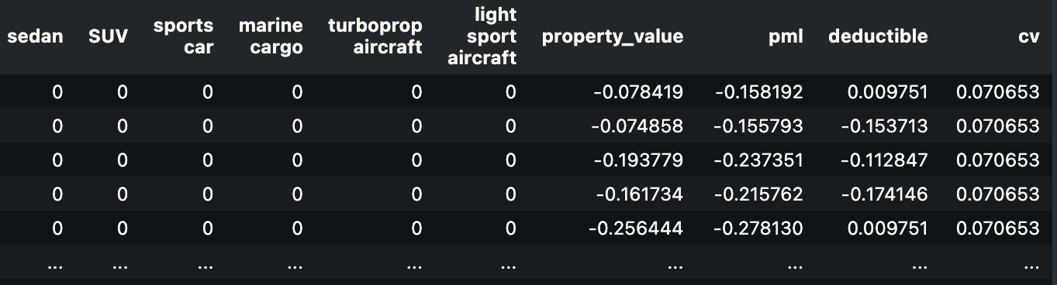
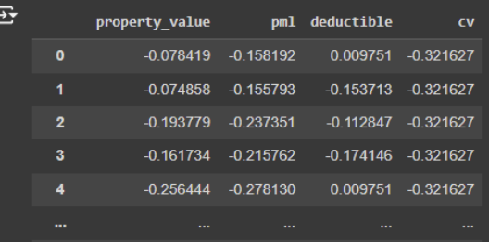
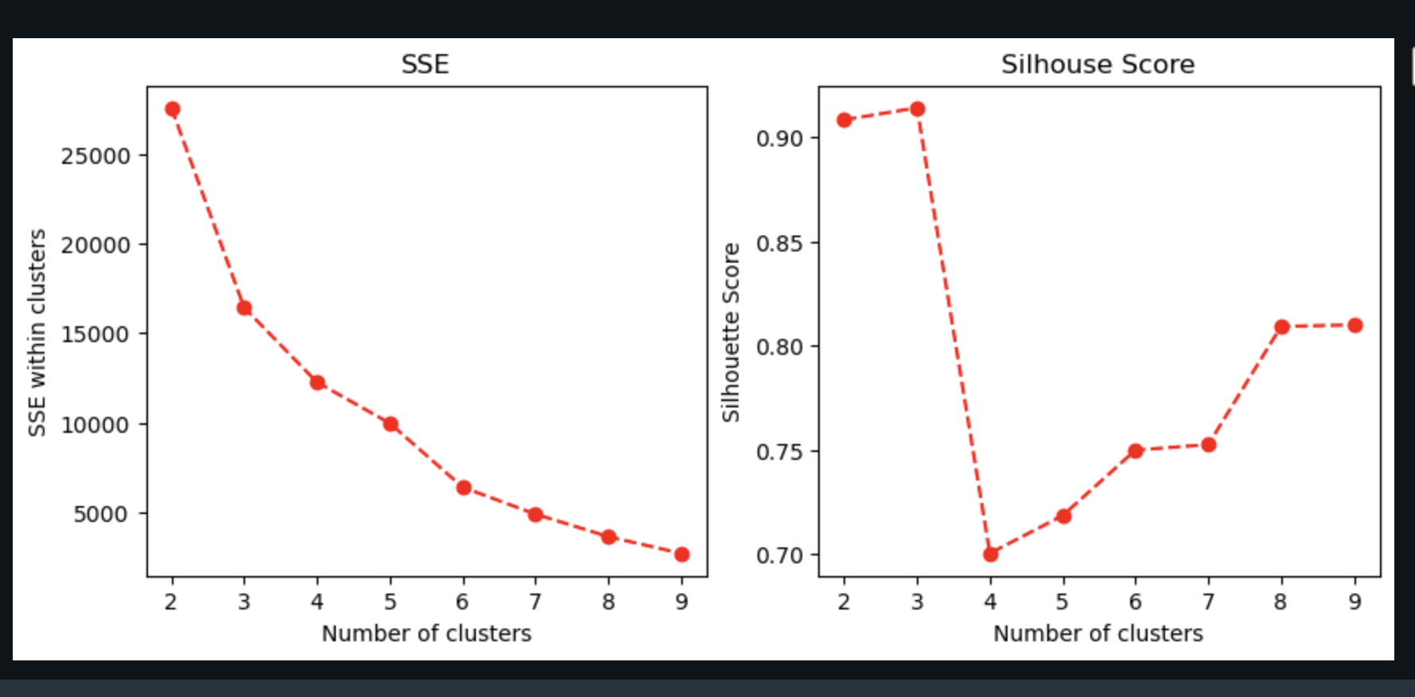
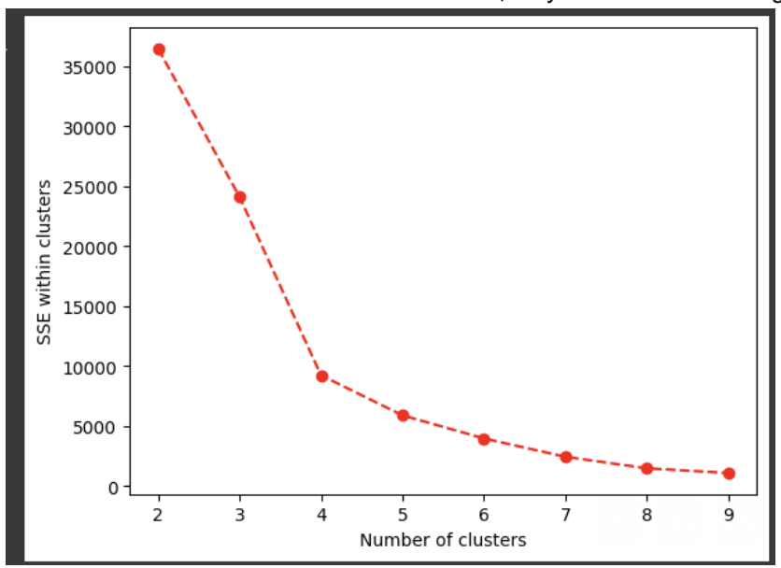
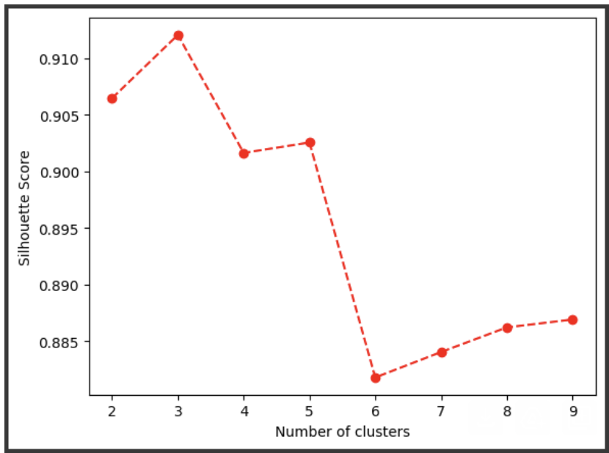
02 - Pending Revision of Clustering Results
Here are 2 changes added to the first version of clustering results (sent by Luyang on 7/18).
1. Include “propery_type” as a feature, using OneHot Encoding.
(old features)
2. The results seems better when k=3.(instead of 4) The reasoning for changing k to 4 is explained in the next page.
New Results
Old Results

Slide 4
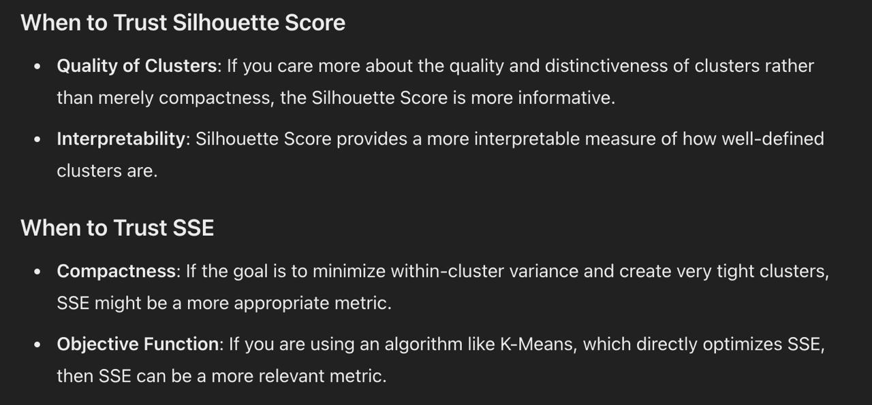

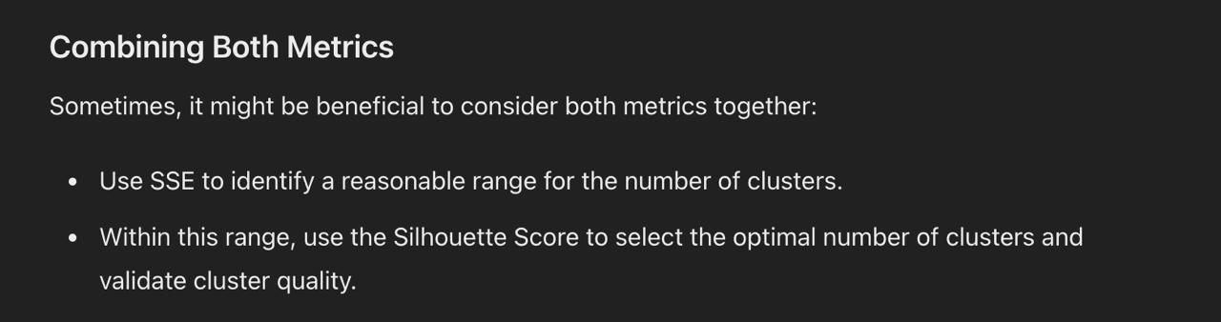
02 - Pending Revision of Clustering Results
The reasoning for changing k to 4:
(According to ChatGPT) when there’s a conflict between SSE and Silhouse Score:
1. It seems like SSE(k=4) is no much smaller than SSE(k=3)
2. SilScore(k=4) is way lower than SilScore(k=3)
3. K=3 has better interpretability:
3 clusters represent 3 risk levels(“high-mid-low”)
k=3 will be easier to justify in the Presentation.

